Slide 1
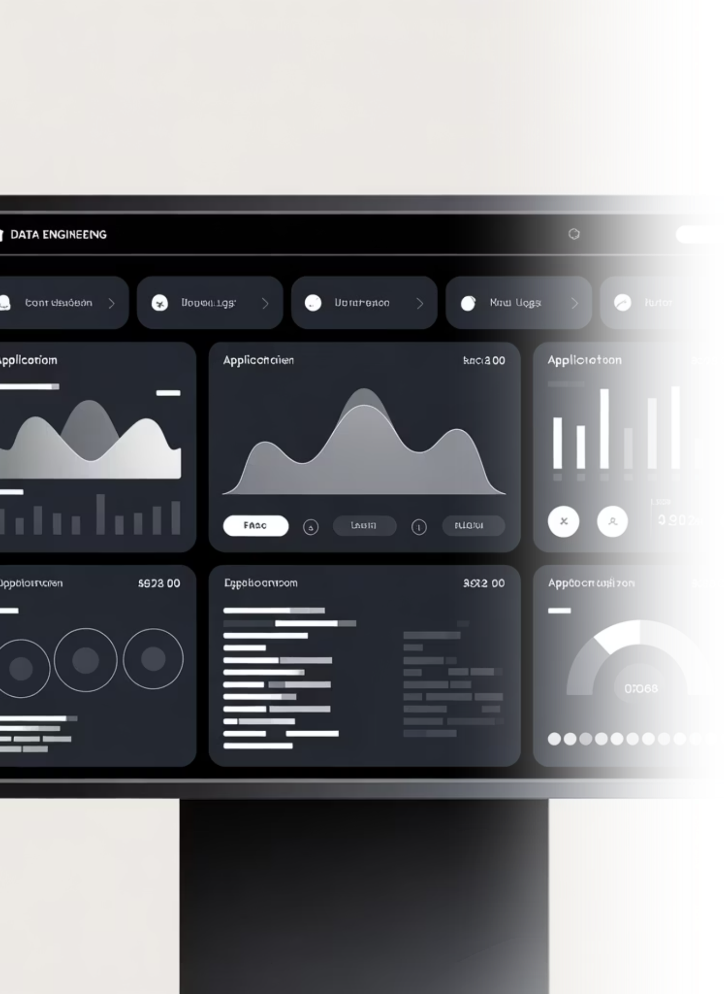
Centralized Application Log Ingestion Service
Unlocking Unified Visibility & Faster Troubleshooting for DE Engineering
A modern approach to managing the exponential growth of application data.

Slide 2

Why Centralize Application Logs?
Distributed systems generate vast amounts of operational data. Without a unified strategy, this data becomes a liability rather than an asset.
Eliminate Blind Spots
Reduce MTTR
Enable Real-Time Insight
Logs scattered across servers and services create critical visibility blind spots for root cause analysis.
Manual log hunting and SSH-ing into servers wastes hours, significantly delaying Mean Time To Resolution (MTTR).
Centralization is the foundation for real-time monitoring, proactive security threat detection, and robust compliance auditing.

Slide 3
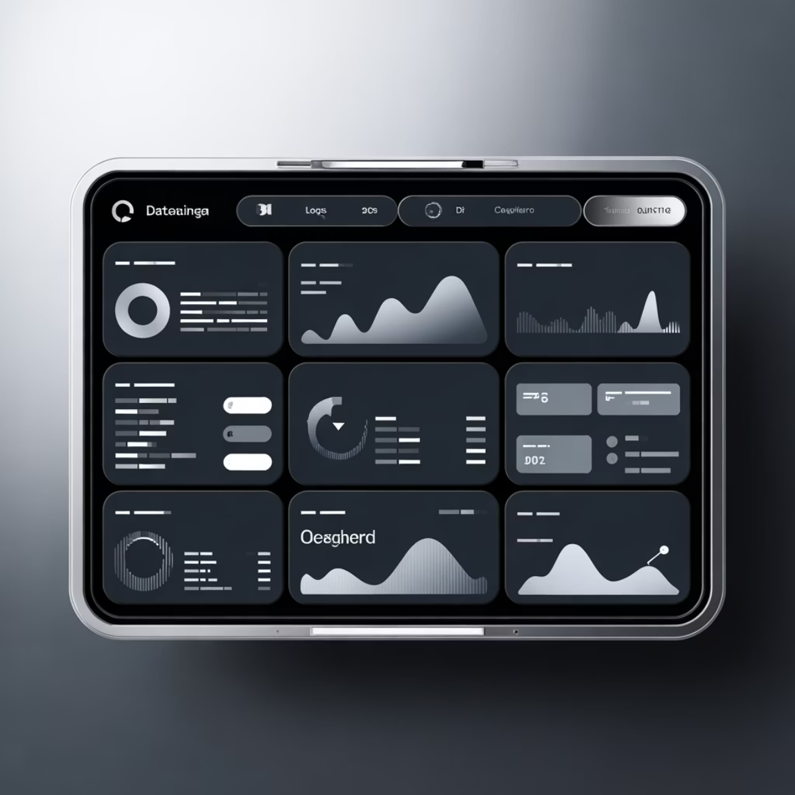
Real-World Stakes: Ensuring Enterprise-Scale Reliability
The Netflix Standard
Netflix ingests massive volumes of logs from thousands of global microservices using a centralized ELK stack.
This architecture achieves rapid issue detection and resolution.
The result: continuous service, ensuring an uninterrupted streaming experience for over 230 million subscribers.
Our Challenge
Modern enterprises face the same challenge, handling terabytes of log data daily. Centralized logging is not optional—it is a mission-critical infrastructure requirement for stability and growth.

Slide 4

Core Benefits of Centralized Log Ingestion
Improved Troubleshooting
A single pane of glass to search, filter, and analyze logs across all applications, dramatically speeding up diagnosis.
Enhanced Security & Compliance
Unified threat detection, anomaly monitoring, and automated auditing streamline compliance reporting and security posture.
Operational Efficiency
Automated alerting based on log patterns and efficient historical log archives reduce operational burden.
Cross-Team Collaboration
Shared, standardized visibility across logs breaks down engineering silos between development, operations, and security.

Slide 5
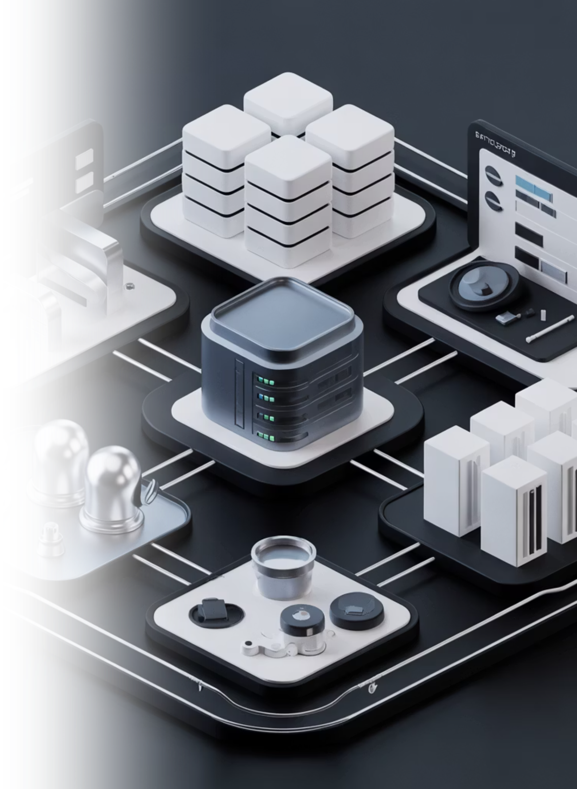

Key Components of a Centralized Logging Solution
A high-level view of the four essential layers required for robust log management.
1. Log Collection Agents
Lightweight forwarders (Fluentd, Logstash, or Fluent Bit) deployed directly on application hosts to gather logs.
2. Log Aggregation & Buffering
Intermediate services like Kafka, Kinesis, or in-memory FIFO buffers to handle traffic spikes and ensure reliable delivery.
3. Storage & Indexing
Search engines like Elasticsearch or Amazon OpenSearch Service for fast, scalable, and complex query processing.
4. Visualization & Analysis
User interfaces like Kibana or OpenSearch Dashboards for creating customizable views and alerts.

Slide 6
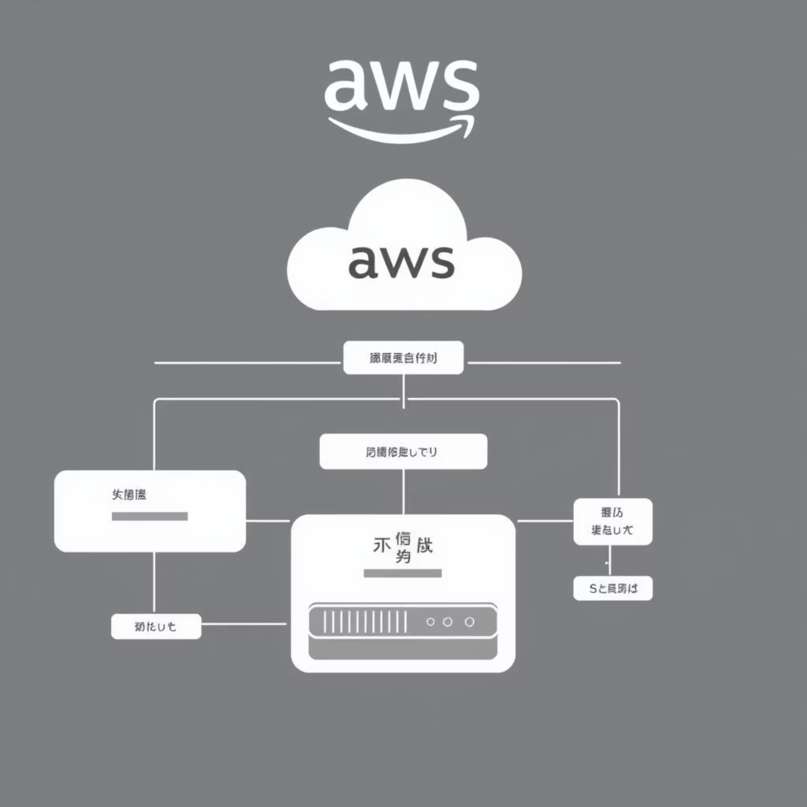
Modern Architecture Example: AWS Centralized Logging with OpenSearch
This cloud-native approach leverages AWS services for serverless scalability and minimal maintenance overhead.
Serverless Ingestion
Pipelines built using AWS Lambda and Step Functions automatically scale with log volume.
Comprehensive Coverage
Logs ingested seamlessly from diverse sources including EC2 instances, EKS containers, S3 buckets, and standard syslog.
Management
Log agents and configurations are consistently monitored and deployed across the fleet using AWS Systems Manager.

Slide 7
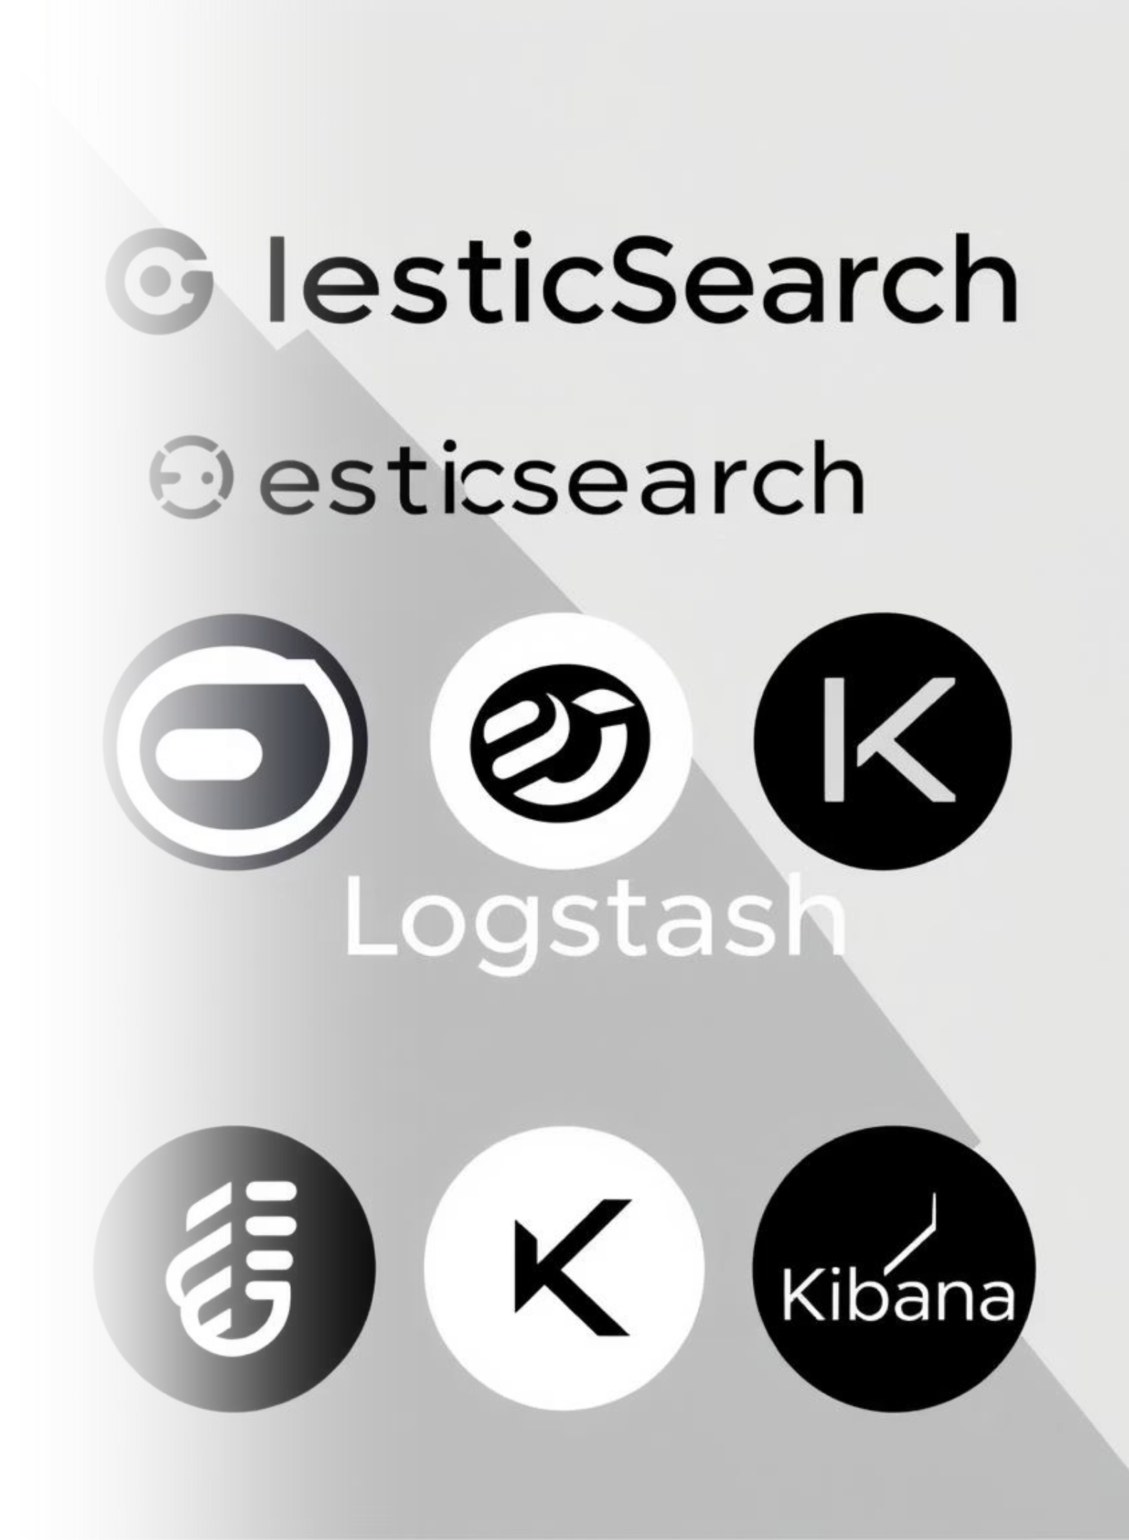
Implementation Focus: The Power of the ELK Stack
The Elastic Stack (Elasticsearch, Logstash, Kibana) remains a robust, flexible, and widely adopted open-source choice for high-volume log management.
Logstash: The Log Processor
Elasticsearch: The Engine
Indexes and stores massive amounts of log data, providing near real-time, highly scalable search and querying capabilities.
Captures, transforms, and filters logs from multiple sources, applying essential structure and schema before storage.
Kibana: The Interface
Visualizes log data with powerful, customizable dashboards and interfaces for deep analytical insights and pattern detection.

Slide 8
Best Practices for Effective Log Ingestion
To truly benefit from centralization, logs must be structured and meaningful.
Standardize & Structure
Implement Correlation IDs
Mandate structured logging (e.g., JSON format) to make logs machine-readable and easily searchable across the system.
Use a unique identifier (Correlation ID) passed through all services to trace complex distributed transactions end-to-end.
Configure Log Levels Wisely
Secure Sensitive Data
Balance the need for detailed debugging information (DEBUG) with the cost and volume of production data (INFO, WARN, ERROR).
Ensure logs are scrubbed of PII or credentials, and implement strong access controls and encryption at rest and in transit.

Slide 9
Anticipating Challenges & Proposing Solutions
Centralized logging introduces infrastructure challenges, but proactive planning ensures success.
High Volume & Velocity
Use Buffering and Scalable Cloud Services
Handling millions of log lines per minute without dropping data.
Implement robust message queues (Kafka, Kinesis) and utilize auto-scaling cloud compute/storage.
Diverse Log Formats
Normalize Logs During Ingestion
Dealing with plain text, key-value pairs, and different schemas from various applications.
Use Logstash or Lambda functions to normalize disparate formats into a unified, structured JSON schema.
Security & Compliance
Encrypt and Audit Access
Protecting sensitive data within logs and meeting industry regulations.
Encrypt logs at rest, enforce strict Role-Based Access Control (RBAC), and actively monitor for data anomalies.
Cost Management
Tiered Storage & Retention Policies
The cost of storing petabytes of indexed log data long-term.
Utilize tiered storage (hot/warm/cold) and define automated retention policies to archive or delete older, less-frequently accessed data.

Slide 10
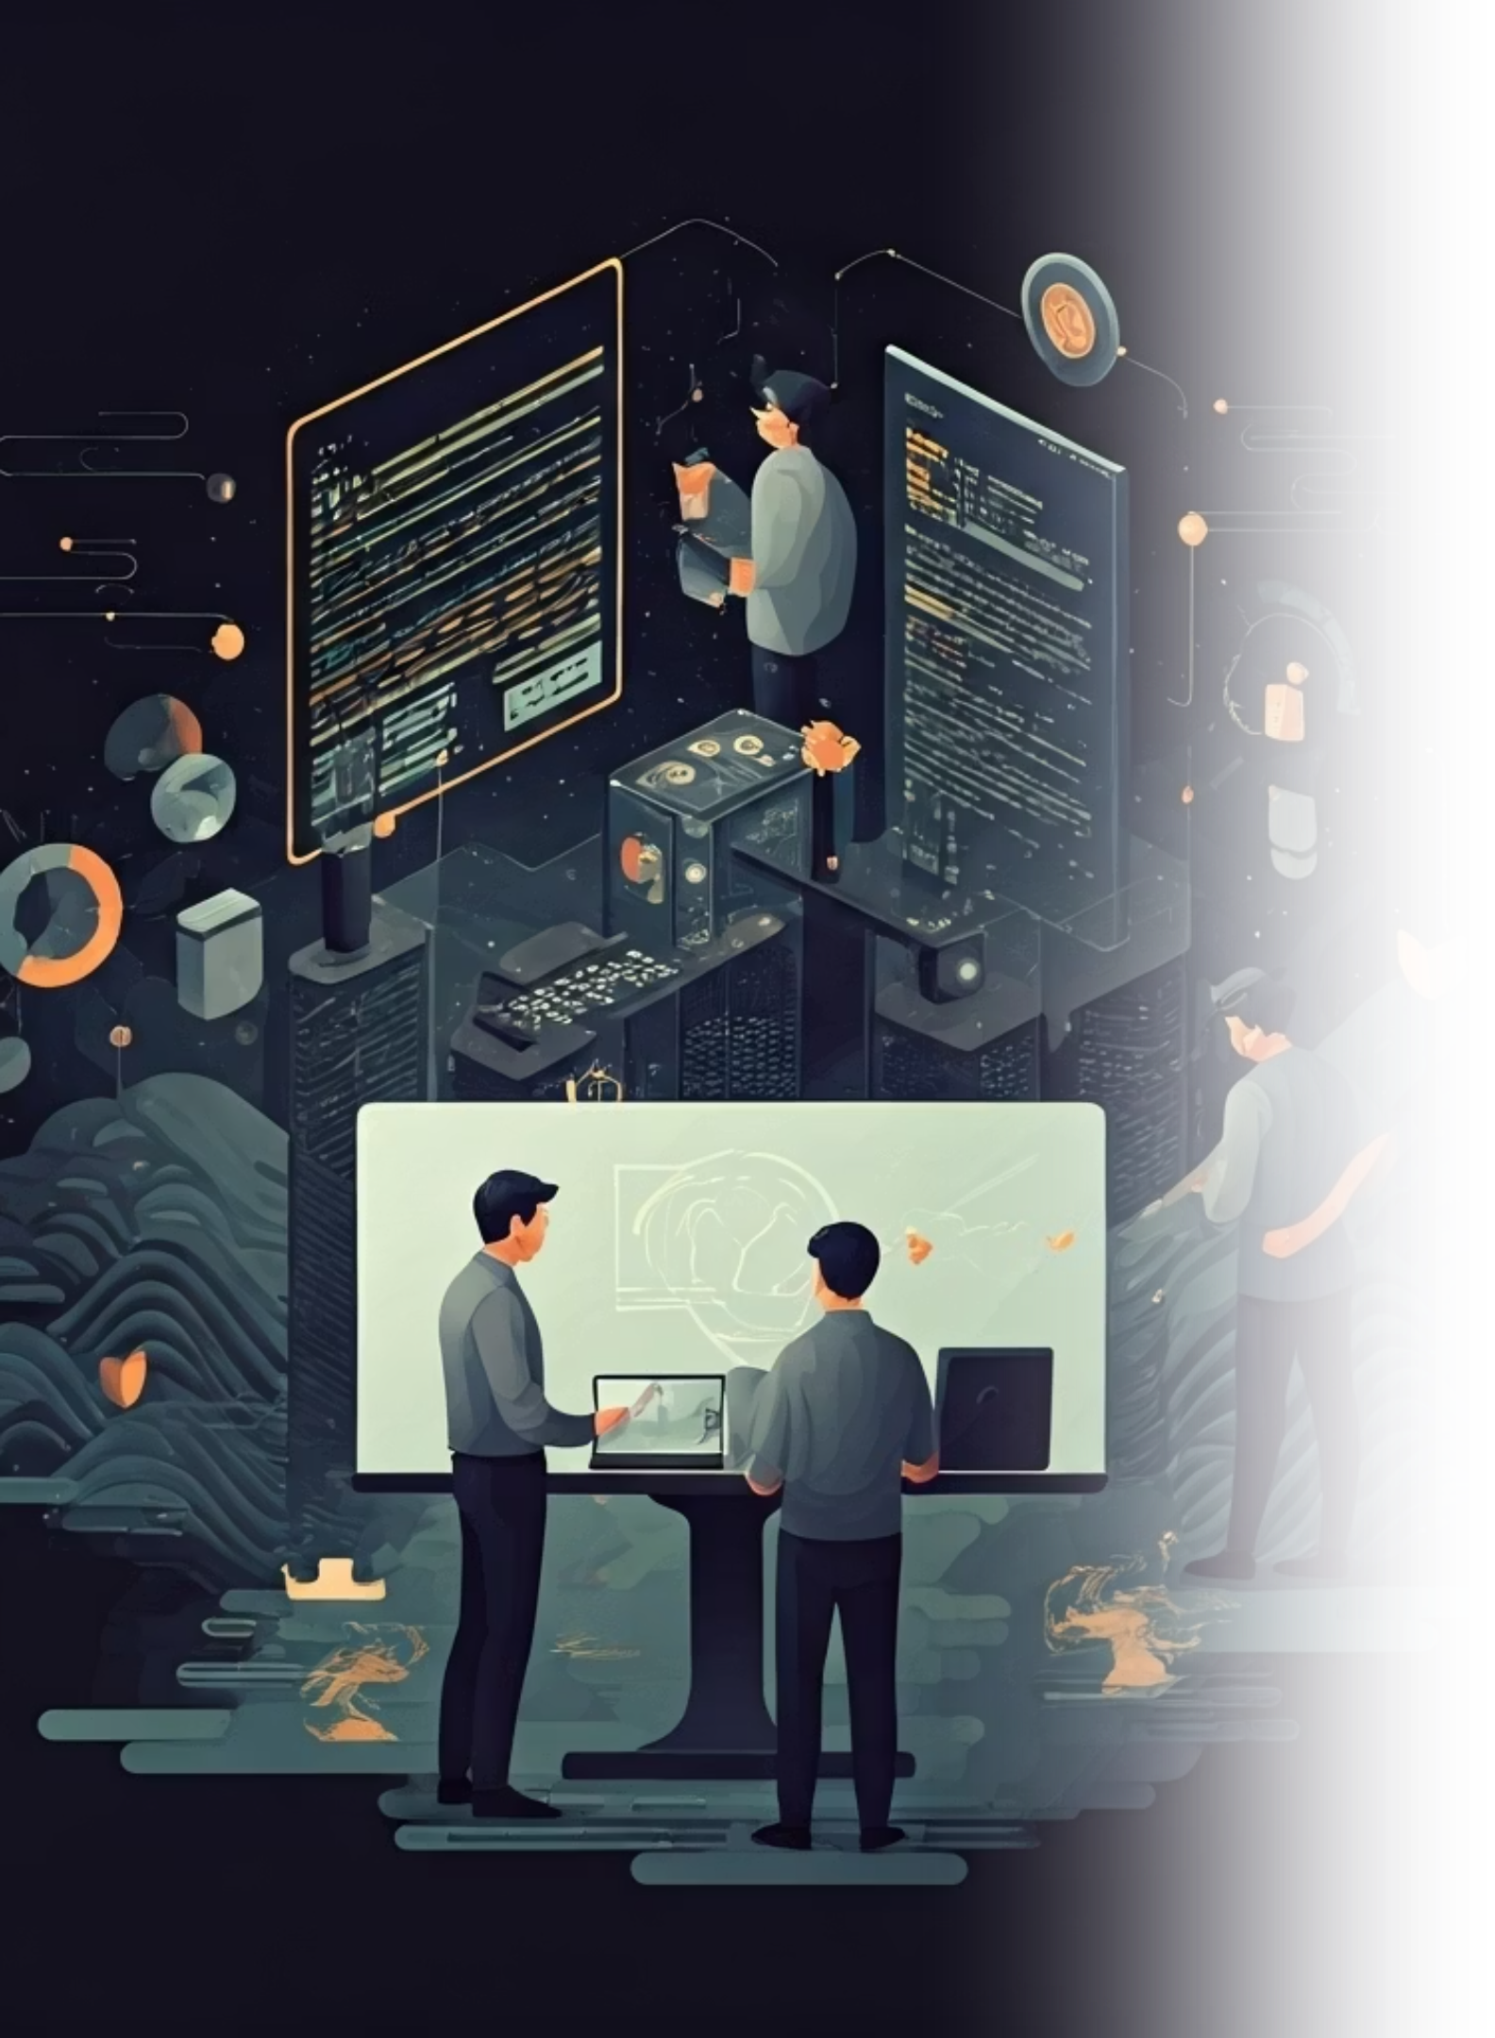

Conclusion
The Path Forward: Empower Your Teams with Centralized Logs
Accelerated Response
Dramatically improve incident response times and reduce system downtime by locating issues instantly.
Holistic Insights
Gain comprehensive, unified insights into application health, performance, and underlying security risks.
Foster Collaboration
Enable seamless collaboration across engineering teams with a single, unified source of truth for all operational data.
Centralized logging is not just infrastructure—it’s your application’s nervous system, providing immediate feedback and ensuring system integrity.

